Slide 1
CLASSICAL THEORIES OF DEVELOPMENT

Slide 2
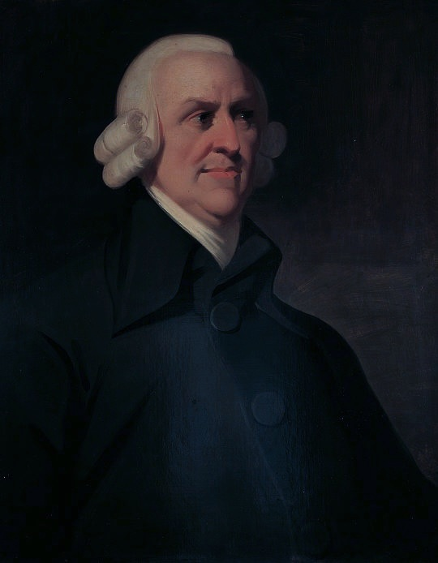
Theory by Adam Smith
An Enquiry into the Nature and Causes of the Wealth of Nations in 1776
Main concern:
Why some countries are richer and some are poorer?
What are the basic economic factors that can increase the wealth of an economy?

Slide 3
Basic concepts of the theory
Natural Law: Where each individual was led by an invisible hand which guided market mechanism. It is not to the benevolence of the baker but to self interest that we owe our bread. Invisible hand in a laissez faire economy is the automatic equilibrating mechanism of the perfectly competitive market to maximize national wealth
Division of labor: Labor specialization increases labor productivity. It leads to increasing returns to scale and hence growth is self-reinforcing. Example of pin factory.
Expansion of commerce and international trade
Increase in population and transport facilities are bound to increase greater division of labor and increase in capital

Slide 4
Why labor specialization increases output?
Skill increases with repetition
Time is saved
The worker can improve her/his performance
Increase in the labor specialization depends on the demand for the product. Hence, division of labor must always be limited by the extent of the market.
Process of capital accumulation: A necessary condition of economic development.
The ability of the people to save more and invest more.
Only capitalists and landlords are capable of savings.
Iron law of wages: Wages tend to equal the amount necessary to meet the subsistence needs of the laborers

Slide 5
To be continued--------
As K , K/L also , labor productivity , Economic growth. There is an existence of wage funds.
If total wage funds > subsistence level, the labor force will increase, competition for employment will become keener and wages will come down to the subsistence level.
Under stationary conditions, wage rates fall to the subsistence level, whereas in periods of rapid capital accumulation, they rise above this level.
Wage rate depends on rate of accumulation and rate of population growth.
.

Slide 6
Stationary state
Although there are increasing returns to labor specialization, growth cannot go on forever. This is because
Competition for labor increases as capital accumulation increases
Employment increases and total wage payment increases
Profits decrease, investments fall, economic growth declines
Ultimately rate of growth becomes zero.
Arises of stationary state

Slide 7
Features of stationary state
No increase in investment dk/dt G S
No increase in output
No increase in wage rate
No increase in the standard of living K
O T (time)

Slide 8
Process of growth: Progressive and stationary
Economy grows like a tree.
Process of growth is cumulative.
Progress in agriculture, industries, and commerce leads to capital accumulation, technical progress, increase in population, expansion of markets, division of labor and rise in profits continuously. This is known as progressive state which ‘is in reality the cheerful and the hearty state to all the different orders of the society’.

Slide 9
How the economy grows: Agents of growth
Agricultural surplus arises due to economic development, demand increases for commercial and manufacturing products.
Leads to commercial progress and manufacturing units. It leads to increase in agricultural production through improved techniques. Thus capital accumulation and economic development take place due to the emergence of the farmer, the producer, and the businessman.

Slide 10
Criticisms
Rigid division of society: No middle class
One-sided saving: No income receivers
Unrealistic assumption of Perfect Competition
Neglect of entrepreneur: Lack of innovation
Unrealistic assumption of stationary state: Fits and start not steady, uniform, and regular like tree
Static model: It does not exhibit a sequence.
Limited to developed countries

Slide 11
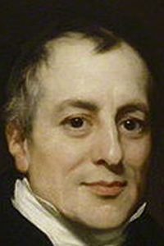
Theory by David Ricardo
The Principles of Political Economy and Taxation
Discussed the theory of distribution which is based on marginal and surplus principle

Slide 12
Assumptions
Supply of land is fixed
Land is used for production of corn and the working force in agriculture helps in determining the distribution in industry
Law of diminishing returns operates on land
Demand for corn is perfectly inelastic
Labour and capital are variable inputs
Capital consists of circulating capital
There is capital homogeneity

Slide 13
To be continued----------
All workers are paid subsistence wages
The state of technological knowledge is given
There is perfect competition
Demand for labour depends upon accumulation of capital
Demand and supply price are independent of the marginal productivity of labour
The supply price of labour is given and constant
Capital accumulation results from profits

Slide 14
Ricardian system
Whole economy consists of large huge firm fixed in supply
Engaged in producing only corn by using homogenous units of capital and labor
Interrelations between three groups in the economy: landlords, capitalists, and laborers among whom the entire production is distributed
The total national output is distributed as rent, profits, and wages between three groups

Slide 15
Division of Rent, Profit and Wage
Rent per unit of labor = Average Product – Marginal Product i.e. (AP – MP)
Total rent = (AP – MP) × KL; where L is the total quantity of labor and K is the total capital applied on land
Wage Rate = Wage fund / number of workers employed at the subsistence level
Profit is determined through capital accumulation

Slide 16
Process of capital accumulation
Depends on two factors:
The capacity to save and
The will to save
Capacity to save depends on the net income of society which is a surplus out of total output after meeting the subsistence needs of the workers
Surplus is directly proportional to the capacity to save and is invested by the landlords and capitalists
The size of this surplus of net income depends on the rate of profit

Slide 17
Process of capital accumulation depends on :
The profit rate: Profits/wages i.e. ratio of profits to capital employed.
As capital consists only of working capital, it is equal to the wage bill.
Capital accumulation will continue as long as rate of profit is positive.
Profits depend on wages, wages depend on the prices of corn which depend on the fertility of marginal land.
Hence, an inverse relationship between wages and profits
Increased production through less workers and more capital results in the fall of corn price, subsistence wage falls, profits increase and more capital accumulation. This increase the demand for labor and the wage rate which in turn will increase population and the demand for corn and price. Thus wages will rise and profits decline

Slide 18
To be continued--------
b. Increase in wages
Increase in wages leads to decline of profits. In this situation, rent also increases which absorbs the rise in the price of corn. These opposite tendencies ultimately retarded capital accumulation
c. Declining profits in other industries
The profits of the farmer regulate the profits of all other trades. Thus in equilibrium money rate of profit earned on capital must be equal in both agriculture and manufacturing industries. The price of corn determines the rate of profit in the industry. When profits decline in the primary sector, profits of all trade declines.

Slide 19
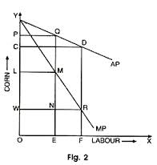
Rents, wages, and profits

Slide 20
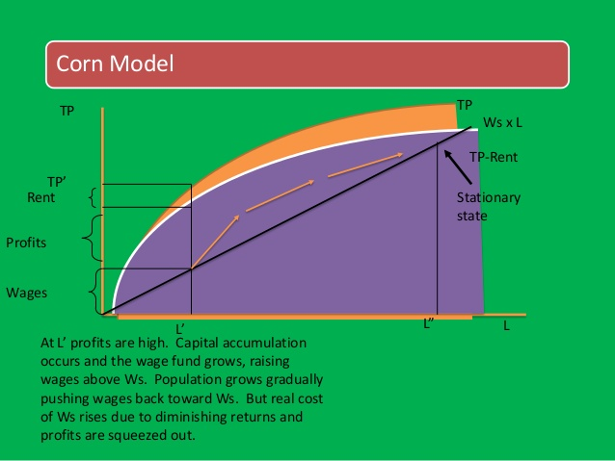

Slide 21
Criticisms
Neglects the impact of technology
Wrong notion of the stationary state
Baseless notion regarding population
Impracticable Laissez-Faire policy
Distribution rather than growth theory

Slide 22
To be continued------
Land also produces good besides corn
Capital and labor not fixed coefficients
Neglects the interest rate
Static model
Limited to developed countries

